Slide 1
Symptom Tracking in Chemotherapy-induced Peripheral Neuropathy
Dr Susanna Park
Brain and Mind Centre, University of Sydney

Slide 2


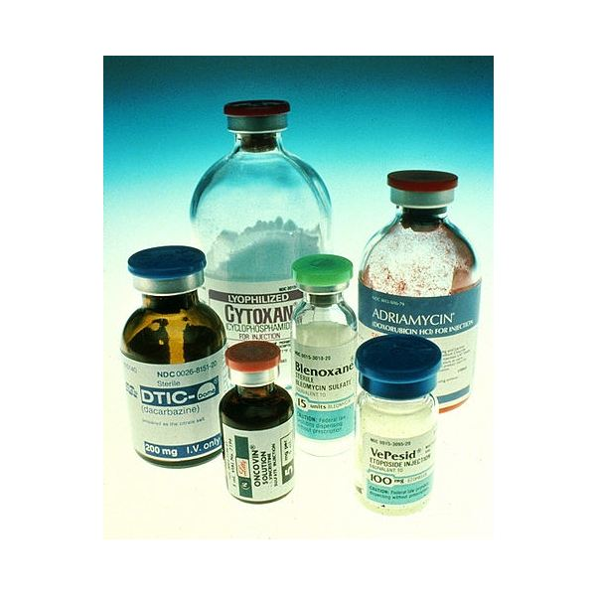
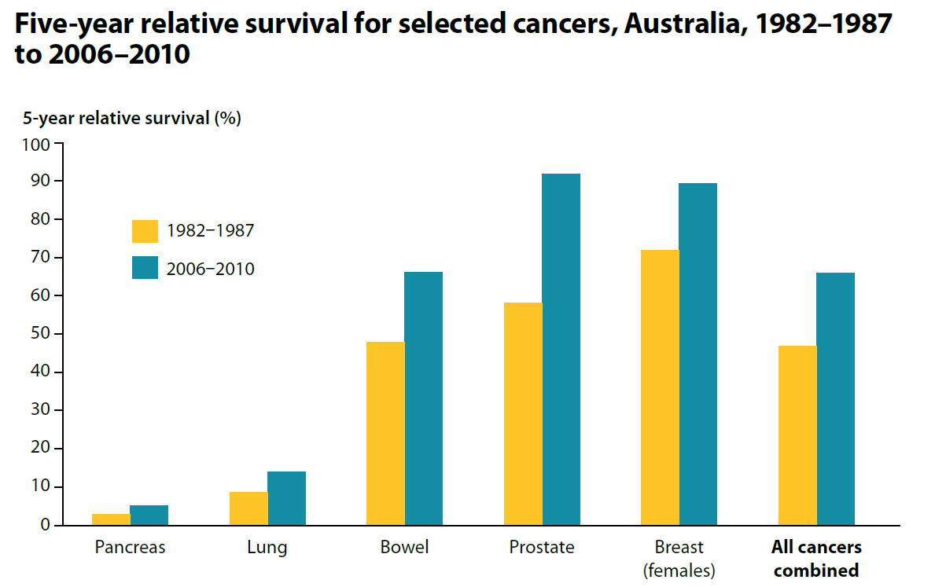
Cancer trajectory
1868 1950 2000 2018
Relative
survival
0%
25%
47%
67+%
Notes:
1868 – AW Campbell was born, 1937 AW Campbell died of cancer

Slide 3
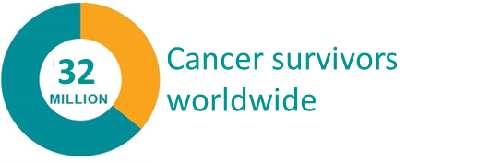
Cancer survivorship
1
Cancer survivors in Australia
million
Survivorship population of all cancers combined, Australia
1,000,000
Long term consequences of cancer treatment for cancer survivors
0
1 year since diagnosis
5 years since diagnosis
>5 years since diagnosis
Source: Australian Institute of Health and Welfare

Slide 4
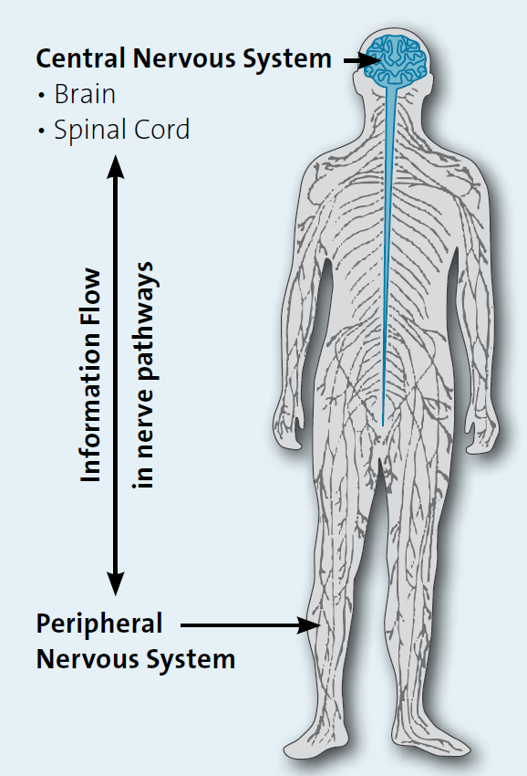
Peripheral Neuropathy
Peripheral nervous system = nerves in the body
Peripheral neuropathy = damage to nerves in the peripheral nervous system
Peripheral neuropathy distorts and interrupts messages between the brain and spinal cord and the rest of the body ~ like static on a telephone line
Nerves are susceptible due to the need for fast, reliable message transmission across long distances
Causes of peripheral neuropathy
Metabolic disorders
Autoimmune conditions
Genetic mutations
Vitamin deficiency
Infections
Paraneoplastic
Toxins and medications
Myeloma Euronet
Notes:
(Hoffman et al 2015 Neurology)

Slide 5
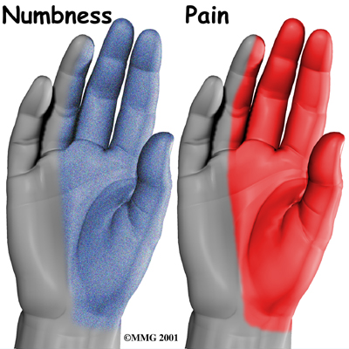
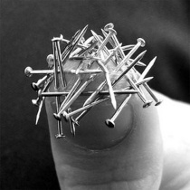
What happens when nerves are damaged?
Sensory, motor or autonomic symptoms
Peripheral neuropathy contributes to functional impairment & healthcare costs
Disability
Falls risk
Opioid use
Causes of peripheral neuropathy
Metabolic disorders
Autoimmune conditions
Genetic mutations
Vitamin deficiency
Infections
Paraneoplastic
Toxins and medications
Notes:
(Hoffman et al 2015 Neurology)

Slide 6
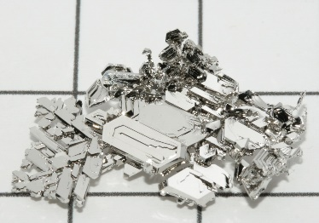

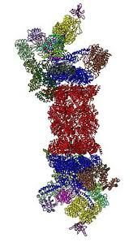

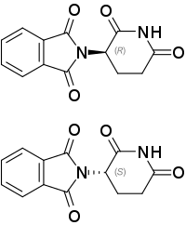
Chemotherapy-induced peripheral neuropathy
>50% of cancer survivors have survived colorectal, breast, ovarian, lung or haematological cancer ~ at risk of chemotherapy-induced peripheral neuropathy (CIPN)
Platinum
Taxanes
Bortezomib
Vinca alkaloids
Thalidomide

Slide 7
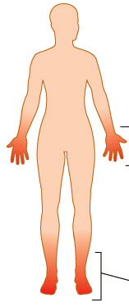
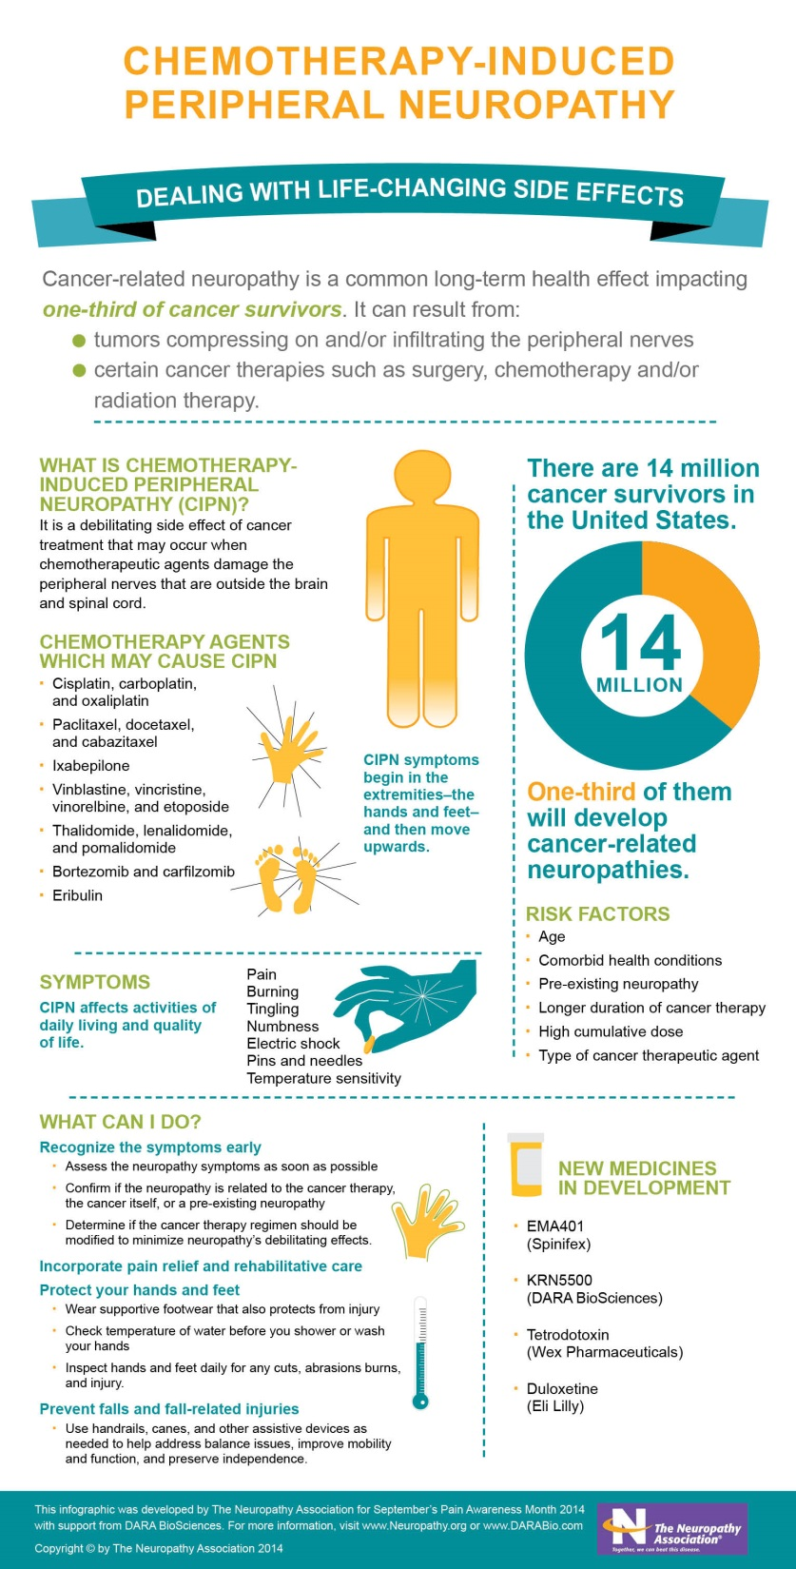
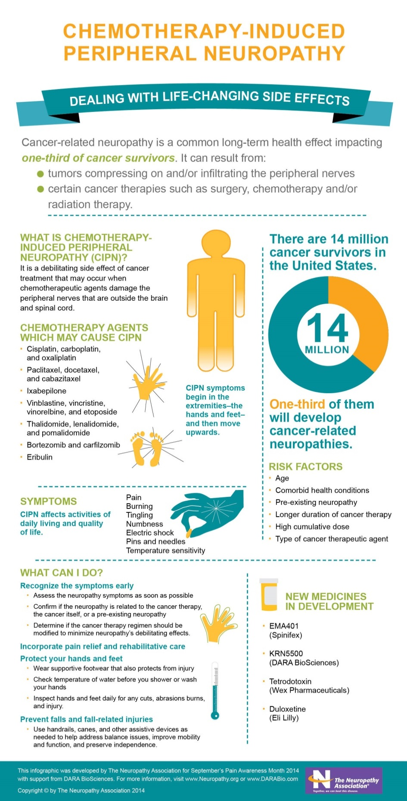
Chemotherapy-induced peripheral neuropathy
>50% of cancer survivors have survived colorectal, breast, ovarian, lung or haematological cancer ~ at risk of chemotherapy-induced peripheral neuropathy (CIPN)
CIPN reduces treatment tolerability & produces long-term deficits
No method to identify at-risk patients
Quantitative and functionally relevant assessment tools are lacking
No effective neuroprotection
Tingling
Difficulty manipulating objects
Loss of sensation
Numbness
Balance, walking & coordination problems
Discomfort

Slide 8
Oxaliplatin-induced neurotoxicity

Slide 9

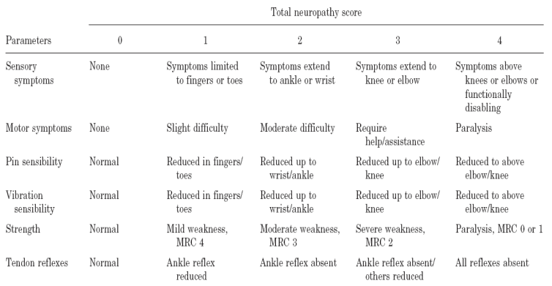
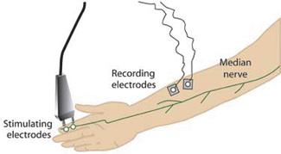
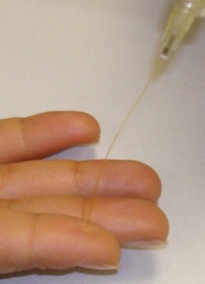
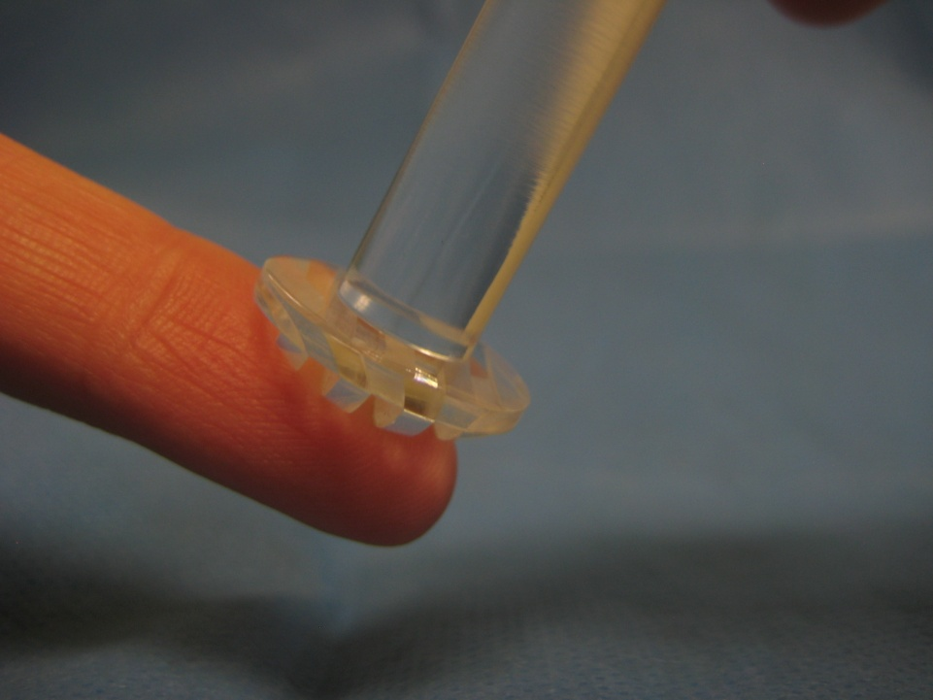
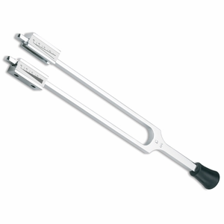
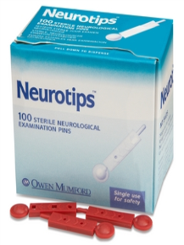
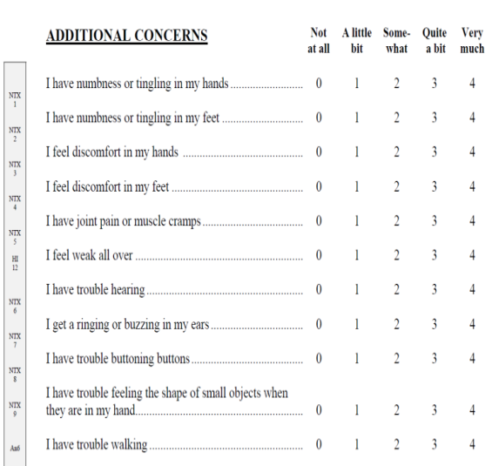

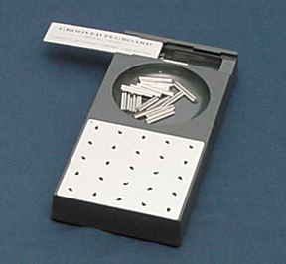
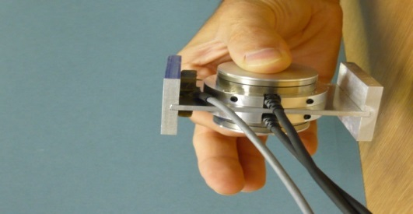
How should we measure nerve damage?
Clinical grading scales
Nerve function
Patient questionnaires
Sensation
Fine motor & dexterity

Slide 10
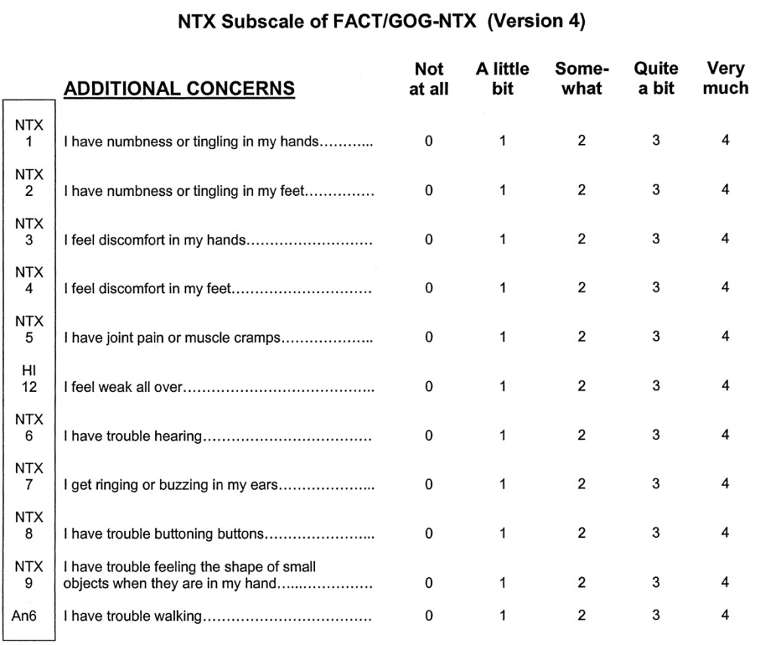
Patient reported outcomes
Validated for use in CIPN
European Organization for Research and Treatment of Cancer EORTC- CIPN20
Functional Assessment of Cancer Therapy FACT/GOG – Ntx
CIPN Rasch-built Overall Disability Scale RODS

Slide 11
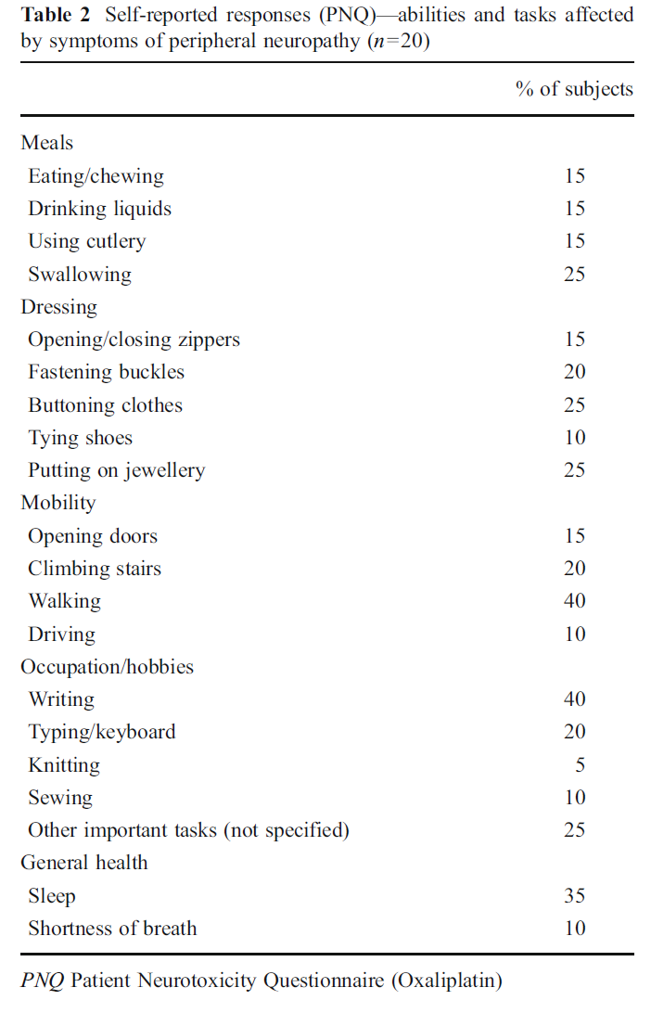
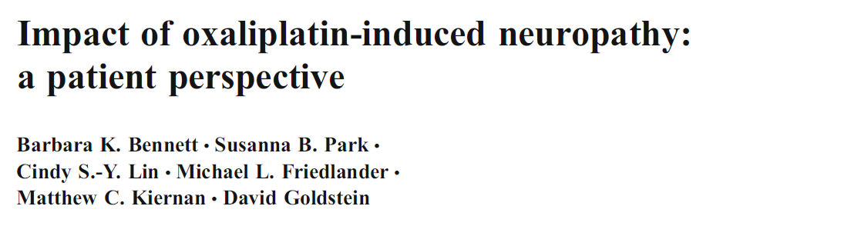
Impact of neuropathy
“Feeling things through a film of glad wrap…”
“Numbness present all the time…”
“Getting very clumsy…”
“No improvement in the past 12 months…”
“It feels like walking on a surface of cotton wool – like the heels and toes are not connecting…”
“Much much worse than I imagined they would be…”

Slide 12

Development of symptom tracking
Enable patients to track and monitor symptoms over time
Enable clinicians to access summarised information
Enable researchers to utilise symptom tracking data
Replace ad hoc paper-based symptom collection methods

Slide 13
Considerations
Key features
Data security
Data sharing and access
Versatility (ability to add content)
Reminders and notifications
Data visualisation/tracking over time
App vs online portal

Slide 14
Next steps
Digital symptom trackers/patient diary
General trackers (i.e. Teamscope, Tally, Symple)
Cancer treatment trackers (i.e. Cancergraph, Chemowave)
Neurological symptom trackers (i.e. Painscale, Catch my pain)
Scoping study
Other types of peripheral neuropathy
Other cancer symptoms
Identify key features needed
Identify best methods of tracking

